Slide 1
Defining the Project Ch. 4-T1
M K Hamirwasia
WILPD

Slide 2
AE/DE/MM/ES/POM ZG523-Merged
Project Management
Lecture No. 12

Slide 3
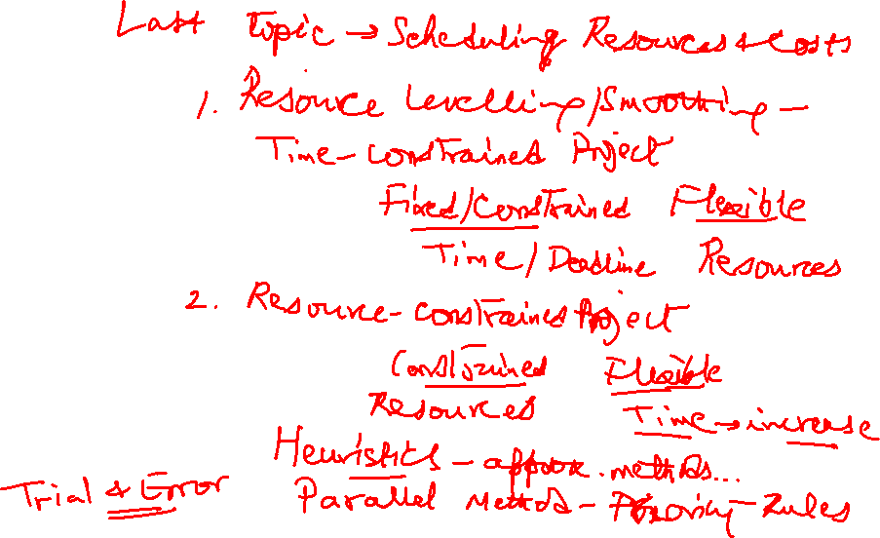

Slide 4
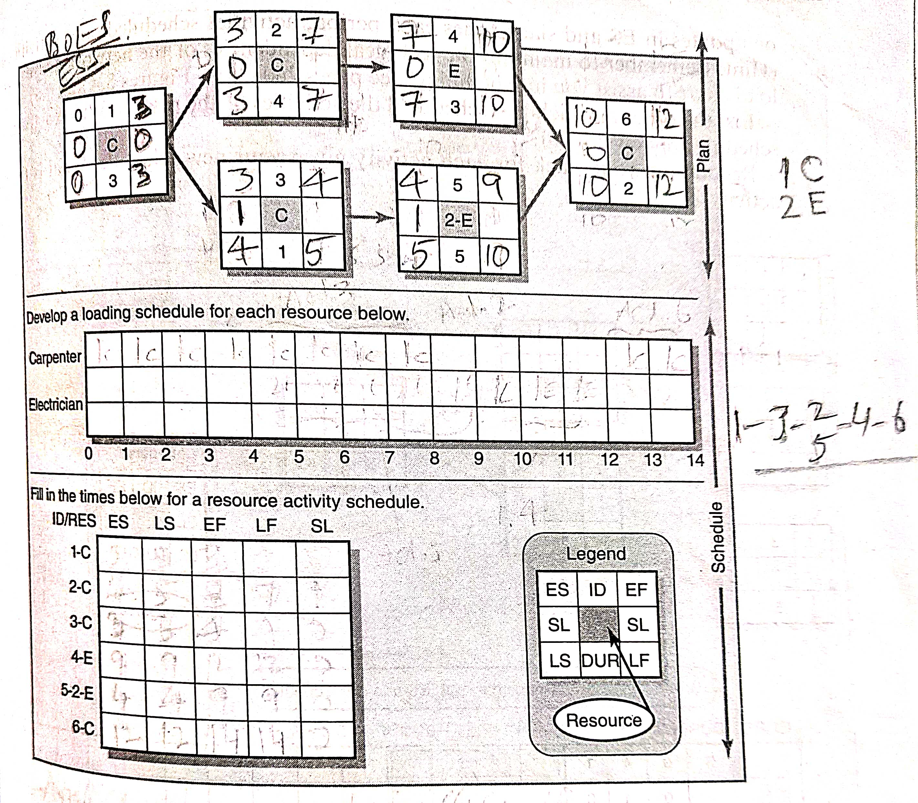

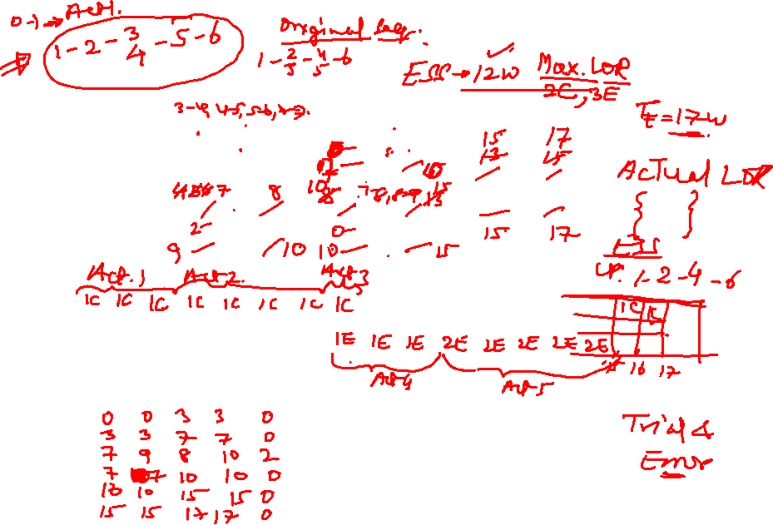

Slide 5

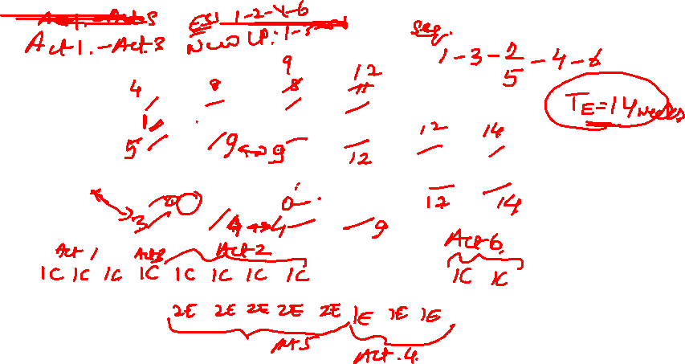

Slide 6
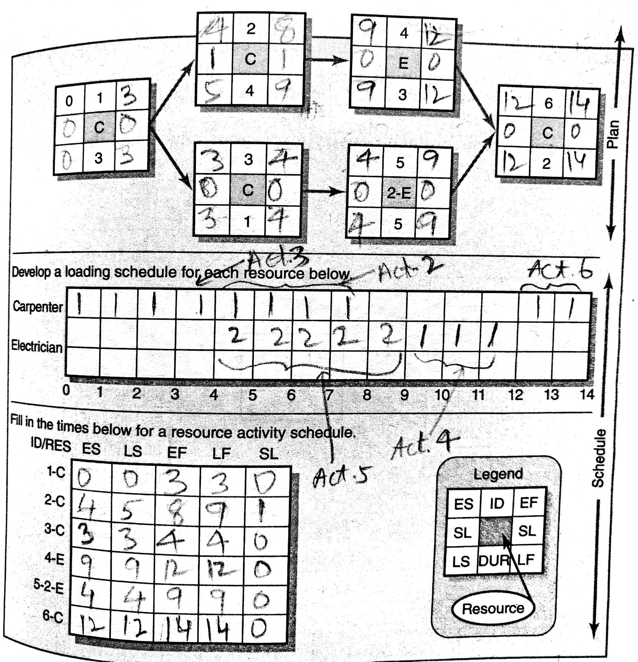

2. p 452

Slide 7
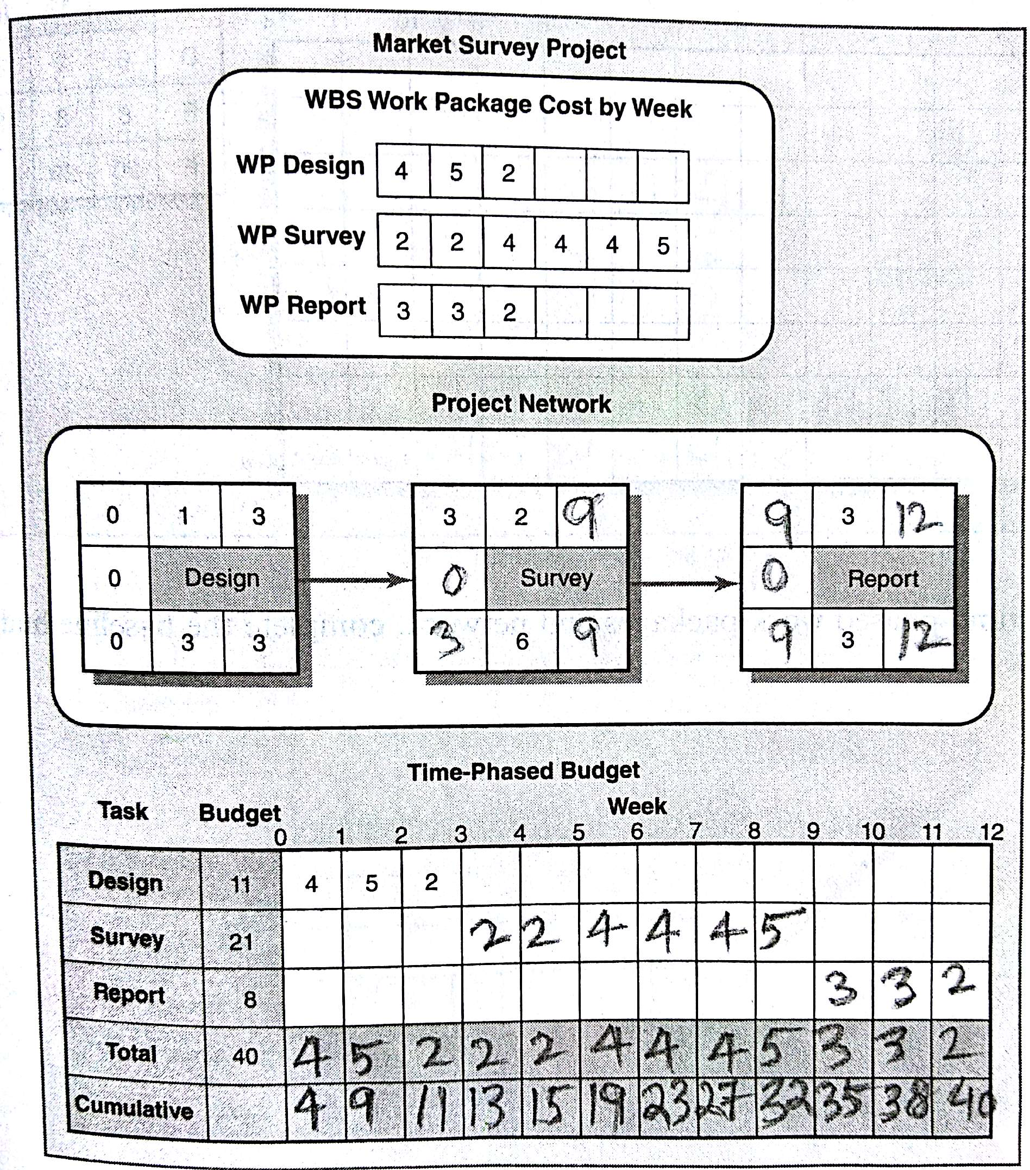
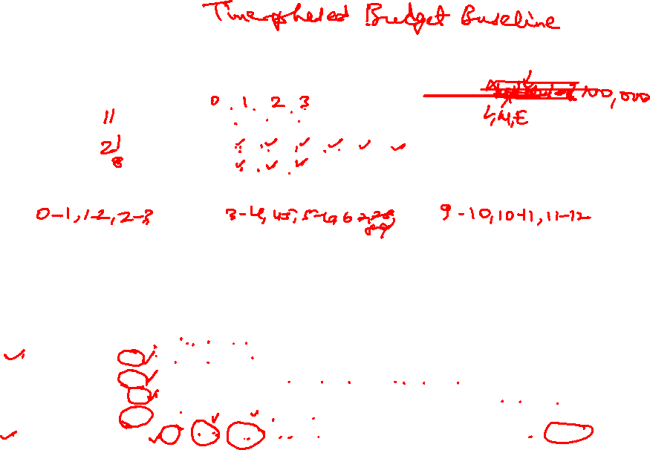
9. p 459

Slide 8
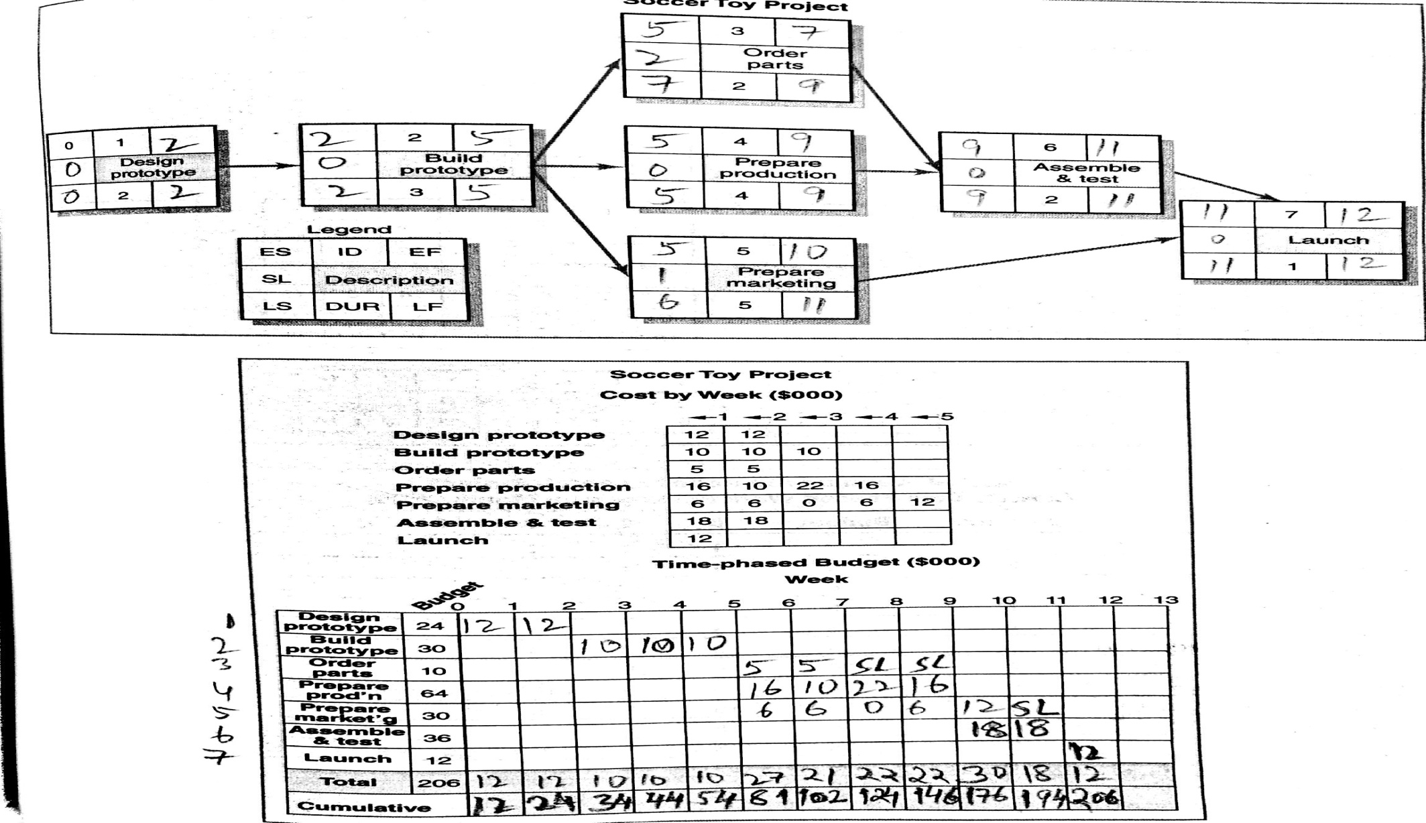

11. pp 460-461

Slide 9
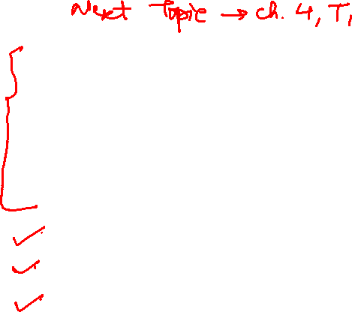
Defining the Project
Defining the Project Scope
Establishing Project Priorities
Creating the Work Breakdown Structure
Integrating the WBS with the Organization
Coding the WBS for the Information System
Process Breakdown Structure
Responsibility Matrices
Project Communication Plan

Slide 10
STEP 1: DEFINING THE PROJECT SCOPE
Defining the Project Scope sets the Stage for Developing a Project Plan
Project Scope is a Definition of the End Result or Mission of the Project in Specific, Tangible and Measurable Terms
The Primary Purpose is to Define the Deliverables for the End User and to Focus Project Plans
Approx 50% of the Planning Problems relate to Unclear Definition of the Scope and Goals
The Scope Doc Directs Focus on the Project Purpose throughout the Life Cycle of the Project for the Customer and Project Participants

Slide 11
Defining the Project Scope
The Scope should be developed under the Direction of the PM, Customer, and other Significant Stakeholders
The PM is responsible for ensuring that there is agreement with the owner on project objectives, deliverables at every stage of the project, tech requirements and so forth
The Project Scope Definition is a Doc that will be published and used by the owner and participants for planning and measuring project success
Scope describes what you expect to deliver to your Customer when the Project is complete
The Project Scope should define the results to be achieved in specific, tangible and measurable terms

Slide 12
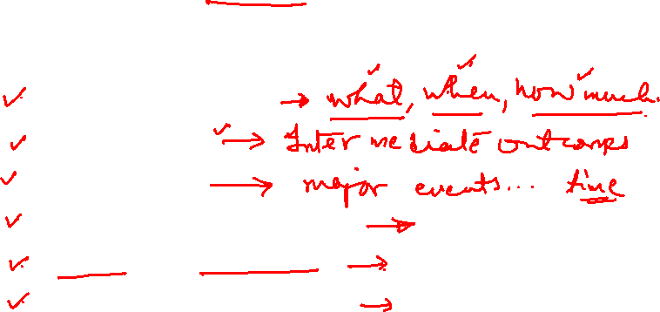
Employing a Project Scope Checklist
We can use a checklist to make sure that scope definition is complete:
1. Project Objective
2. Deliverables
3. Milestones
4. Technical Requirements
5. Limits and Exclusions
6. Reviews with Customer

Slide 13
1. PROJECT OBJECTIVE
Define the Overall Objective to meet Customer’s Needs
The Project Objective answers the Questions of What, When and How Much

Slide 14

2. DELIVERABLES
Define major Deliverables – the expected measurable Outputs over the Life of the Project
List of specifications
S/w Coding and a technical manual
The Prototype
Final Tests and approved s/w

Slide 15
3. MILESTONES
A Significant Event in a Project that occurs at a Point in Time
The milestone schedule shows only major segments of work: it represents rough-cut estimates of Time, Cost and Resources for the Project
Milestones should be important Control Points in the Project and easy to recognize for all Project Participants

Slide 16

4. TECHNICAL REQUIREMENTS
To Ensure Proper Performance
Speed
Mileage
Capacity
Technical requirements define the performance specifications.

Slide 17
5. Limits and Exclusions
The limits of scope should be defined lest it should result in false expectations and spending time and resources on the wrong problem
Eg. Maintenance and Repair will be done only up to one month after Final Inspection
Exclusions further define the boundary of the project by stating what is not included.
Eg. A house will be built, but no landscaping or security devices added

Slide 18
6. REVIEWS with CUSTOMER
Review with customer – internal or external
Understanding and Agreement of Expectations
Is the customer getting what he desires in deliverables?
Does the project definition identify key accomplishments, cost, schedule and quality requirements?
Are issues regarding limits and exclusions covered?
Clarity in all these matters is necessary to avoid claims or misunderstanding.

Slide 19

Defining the Project Scope
Scope Definition should be as brief as possible but complete; one or two pages are typical for small projects.
A few Companies engaged in contracted work refer to scope statements as “Statements Of Work” (SOW). Other Organizations use the term Project Charter.
A project charter refers to a written Doc issued by upper mgmt that authorizes the PM to initiate and lead the Project using Organizational resources for Project activities
Includes Risk Limits, Customer Needs, Spending Limits, Team Composition as well as a brief scope description

Slide 20

Statement of Work
It defines project-specific activities, deliverables, and timelines for a vendor/supplier/contractor providing services to the client.
SOW
Project Name
Introduction
Background
Scope of Work
Objectives
Tasks Task#1, Task#2, …
Schedule – laying out the major milestones
Terms of Payment

Slide 21

The Project Charter
The PC should contain the rationale for the project, the reasons for its existence, who initiated it, and why. In other words, the core project foundation.
The following checklist can be used for a PC:
The purpose and justification of the project
Project objectives, or other success criteria
High level requirements – sth the product or service must do or a quality it must have.
Project description
Product characteristics
Risks

Slide 22

The Project Charter
7. Basic milestones
8. Sample Budget
9. Stakeholders
10. Critical success factors
11. Roles and responsibilities (PM and/or team)
12. Project sponsors, clients etc.

Slide 23
SCOPE CREEP
It is the tendency for the Project Scope to stretch over time – usually by changing requirements, specifications and priorities.
A scope statement that is too broad is an invitation for scope creep.
It mostly means added costs and possible project delays. Changes in requirements, specs and priorities result in cost overruns and delays.
However, if the project scope needs to change, then it is necessary to have a sound change control process in place that records the change and keeps a log of all project changes.

Slide 24
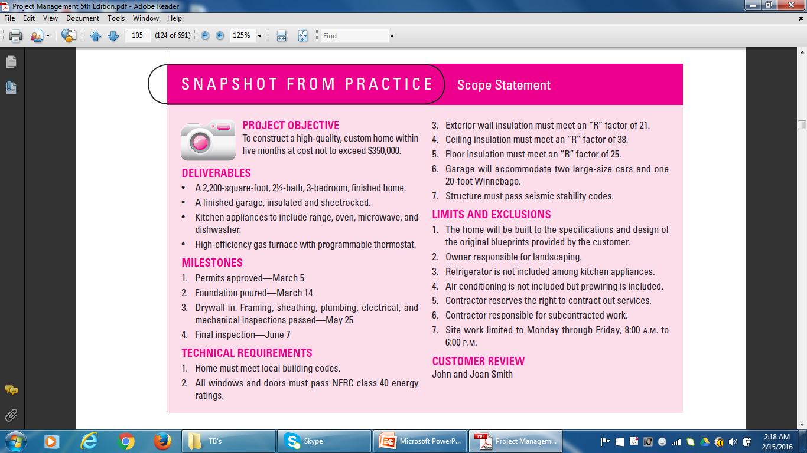

Scope Statement

Slide 25
STEP 2: ESTABLISHING PROJECT PRIORITIES
Tradeoffs among Time, Cost and Performance
Define and Understand the nature of the Priorities of the Project
Establish the relative importance of each criterion
Eg. If midway through the project, a trade-off must be made b/w cost and expediting, which criterion has priority?
One technique useful for this purpose is completing a priority matrix for the project to identify which criterion is constrained, which should be enhanced, and which can be accepted.

Slide 26
PRIORITY MATRIX
Constrain: The original parameter is fixed. The project must meet the Completion Date, Specifications and Scope of the Project, or Budget.
Enhance: In the context of time and cost, it means to either reduce costs or shorten the schedule. Conversely, with regard to performance, enhancing means adding value to the Project.
Accept: For which criterion is it tolerable not to meet the original parameters?

Slide 27
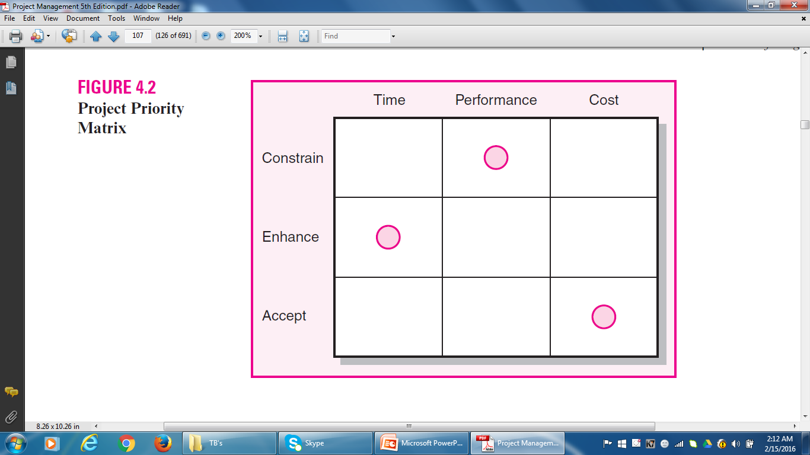

Project Priority Matrix

Slide 28
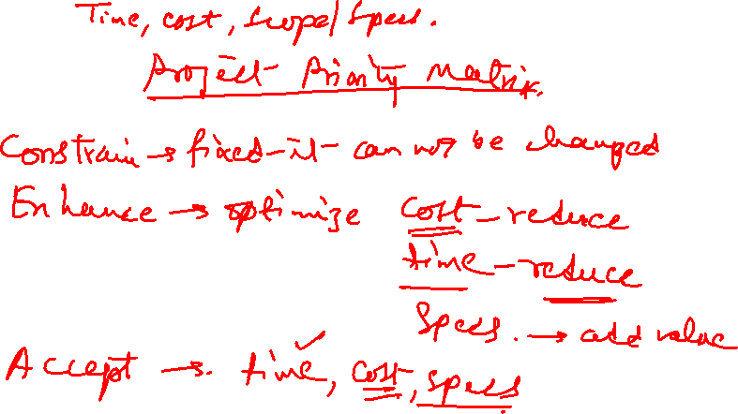

Slide 29
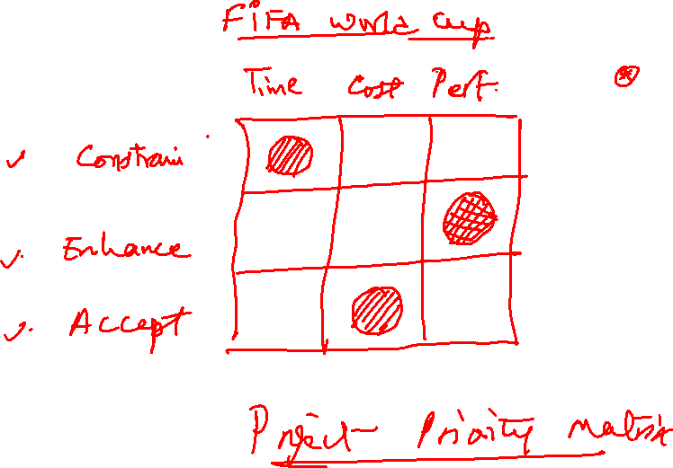

Slide 30
STEP 3: CREATING THE WORK BREAKDOWN STRUCTURE
A Work Breakdown Structure (WBS) is used for breaking down a project into easily manageable components, or bites.
Company owners and project managers use the Work Breakdown Structure (WBS) to make complex projects more manageable.
The WBS is designed to help break down a project into manageable chunks that can be effectively estimated and supervised.

Slide 31
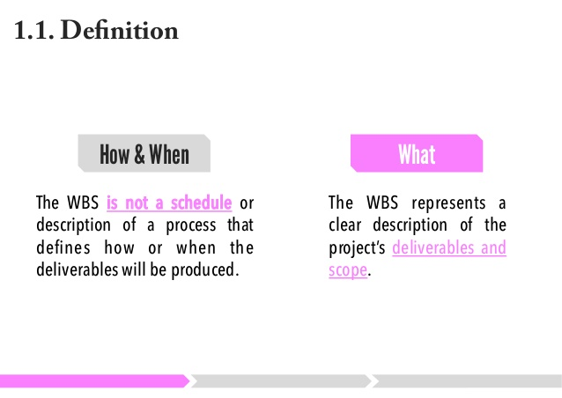
WBS

Slide 32
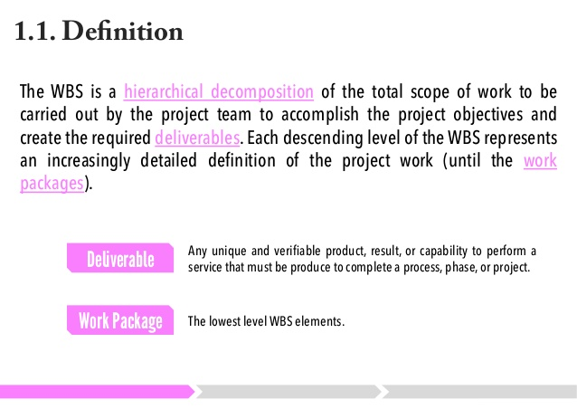
WBS

Slide 33
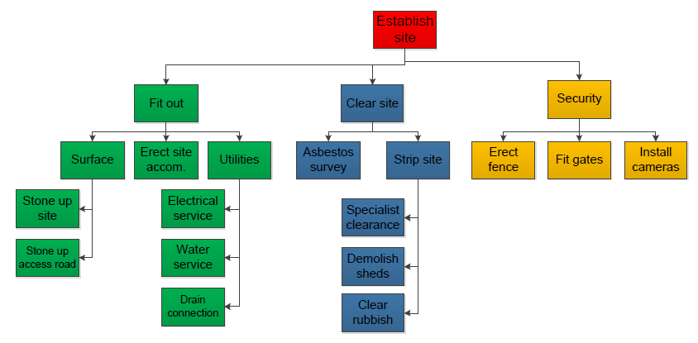
Simple WBS Example

Slide 34
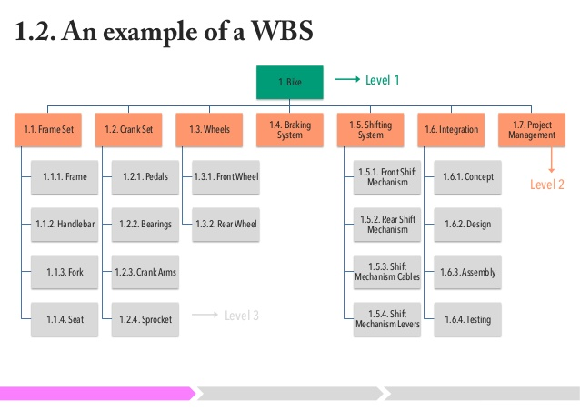
Bicycle WBS

Slide 35
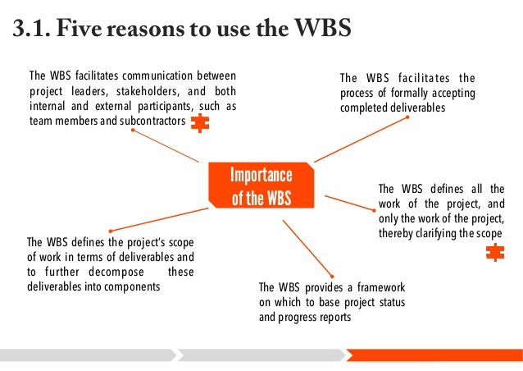
WBS

Slide 36
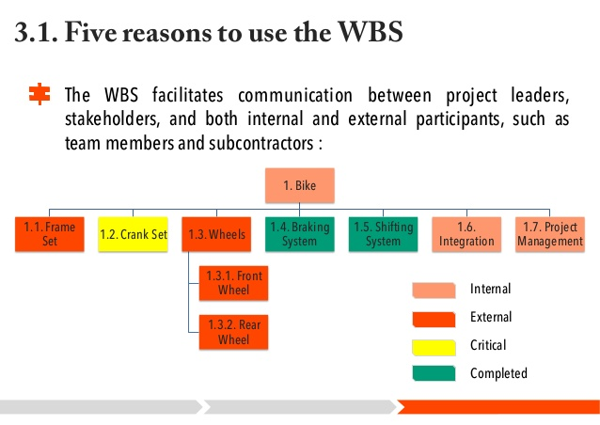
WBS

Slide 37
Constructing a Work Breakdown Structure
To start out, the project manager and subject matter experts determine the main deliverables for the project. Once this is completed, they start decomposing the deliverables they have identified, breaking them down to successively smaller chunks of work.
"How small?" you may ask. That varies with project type and management style, but some sort of predetermined “rule" should govern the size and scope of the smallest chunks of work. There could be a two weeks rule, where nothing is broken down any smaller than it would take two weeks to complete.
You can also use the 8/80 rule, where no chunk would take less than 8 hours or longer than 80 hours to complete.

Slide 38
Format
Regarding the format for WBS design, some people create tables or lists for their work breakdown structures, but most use graphics to display the project components as a hierarchical tree structure or diagram.

Slide 39
What is a Work Breakdown Structure Diagram?
A WBS diagram expresses the project scope in simple graphic terms. The diagram starts with a single box or other graphic at the top to represent the entire project. The project is then divided into main, or disparate, components, with related activities (or elements) listed under them. Generally, the upper components are the deliverables and the lower level elements are the activities that create the deliverables.

Slide 40
WBS Checklist
This is a checklist to use when reviewing the quality of a Work Breakdown Structure.
Does it define 100% of the work that will be produced by the project?
Does each element represent a deliverable?
Does it use a coding structure so that each element has a unique ID that shows its place in the hierarchy e.g. 1.1, 1.2, 1.1.1, 1.1.2?
Will project stakeholders be able to understand the project scope from the WBS?
Does it capture all external and internal deliverables including project management deliverables?

Slide 41
WBS Checklist
Does each level represent 100% of the work required to deliver the parent level?
Is the decomposition sufficient that the tasks required to deliver each work package can easily be identified?
Is it in the format that gives a clear graphical, textual or tabular breakdown of the project scope?
Is a hierarchical structure used?
Does it have at least two levels with at least one level of decomposition?
Was it created by those who will be performing the work?
Is it being regularly updated as project changes are approved?

Slide 42
WBS Checklist
Can you identify one person who is accountable for each work package?
Can you clearly define the acceptance criteria for each work package?
Does it allow you to estimate costs accurately?
Does the WBS have logical summary elements that can be used in tracking progress and performance?
Does the WBS provide sufficient detail to create an Organizational Breakdown Structure and Resource Assignment Matrix?
Is there an alignment between the WBS and project accounting structures?

Slide 43
WBS Checklist
Is the WBS sufficient to support reporting at a team, project, program and portfolio level?
Does the WBS align with the size and complexity of the project?
Is it sufficiently detailed to support planning and control, but not so detailed as to become cumbersome?

Slide 44
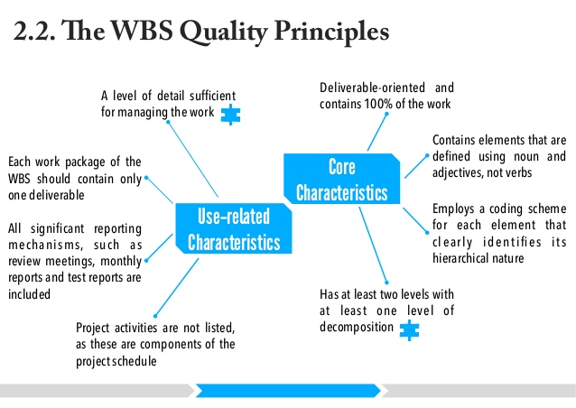
WBS

Slide 45
How WBS Helps the PM
The hierarchical structure facilitates evaluation of cost, time and performance at all levels in the organization over the life of the project.
The WBS also provides mgmt with info appropriate to each level. Eg. Top mgmt deals with major deliverables, while first-line supervisors deal with smaller sub deliverables and work packages.
Each item in the WBS needs a time and cost estimate. The WBS also serves as a framework for tracking cost and work performance.

Slide 46
How WBS Helps the PM
As the WBS is developed, organizational units and individuals are assigned responsibility for executing work packages. This integrates the work and the organization. This process is sometimes called the organization breakdown structure (OBS).
The WBS can also be used to define communication channels and assist in understanding and coordinating many parts of the project.
The structure shows the work and organizational units responsible and suggests where written communication should be directed.
Problems can be quickly addressed because the structure integrates work and responsibility.

Slide 47
WBS Development
At the top is the project end item.
This is broken into major deliverables.
Define sub deliverables necessary to accomplish the larger deliverables.
Each sub deliverable includes work packages that will be completed by an assigned organizational unit.
A sub deliverable includes outcomes of more than one work package from perhaps 2 or 3 departments.
The lowest level of the WBS is called a work package. Work packages are short-duration tasks that have a definite start and stop point, consume resources, and represent cost. Each work package is a control point.

Slide 48
WORK PACKAGE
A work package manager is responsible for seeing that the package is completed on time, within budget, and according to technical specifications.
Thus, the work package is the basic unit used for planning, scheduling and controlling the project.
Each work package in the WBS
1. Defines work (what).
2. Identifies time to complete a work package (how long).
3. Identifies a time-phased budget to complete a work package (cost).
4. Identifies resources needed to complete a work package (how much).

Slide 49
WBS Development
5. Identifies a single person responsible for units of work (who).
6. Identifies monitoring points for measuring progress (how well).
Every effort should be made to develop a WBS that is output oriented.

Slide 50
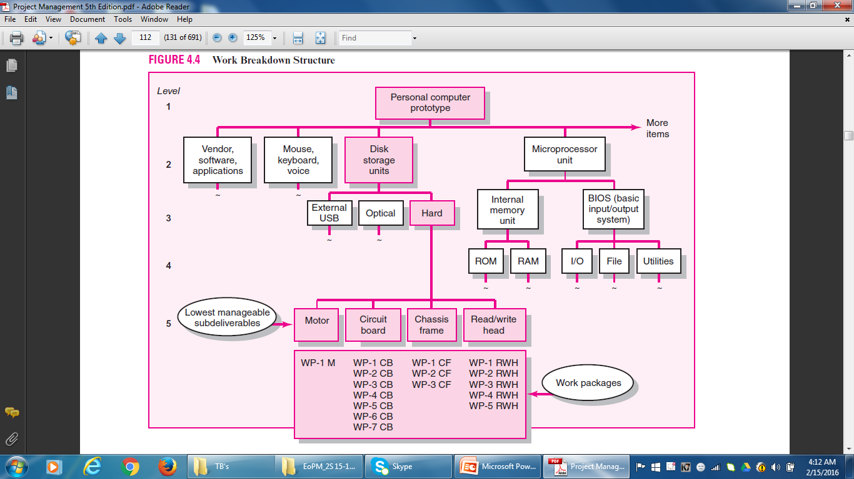
WBS

Slide 51
STEP 4: INTEGRATING the WBS with the ORGANIZATION
The WBS is used to link the organizational units responsible for performing the work. The outcome of this process is the OBS. The OBS depicts how the firm has organized to discharge work responsibility.
The purpose of the OBS are to provide a framework to summarize organization unit work performance, identify organization units responsible for work packages, and tie the organizational unit to cost control accounts.
The intersection of work packages and the organizational unit creates a project control point (cost account) that integrates work and responsibility.

Slide 52
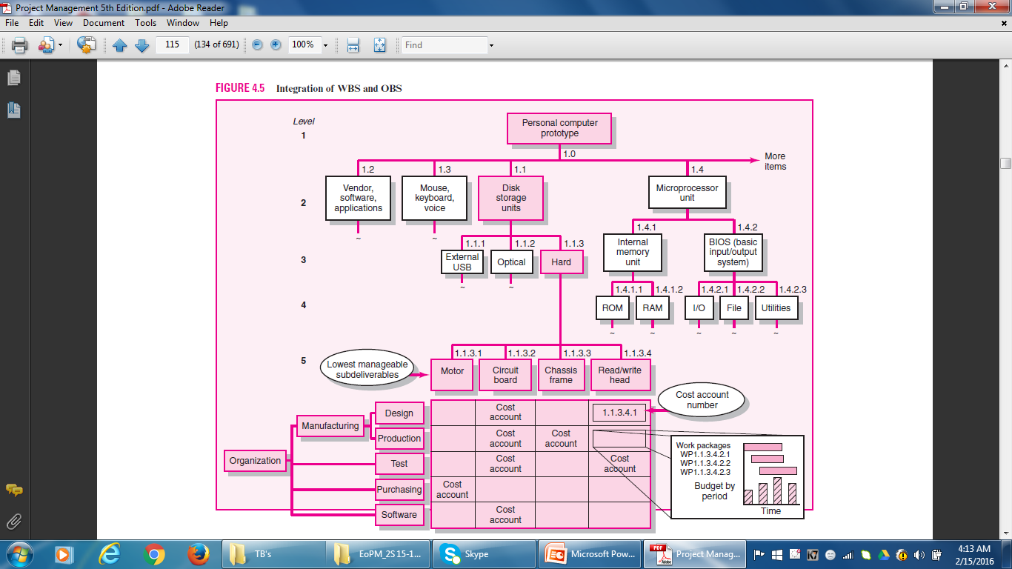
Integrating WBS and OBS

Slide 53
STEP 5: CODING the WBS for the INFORMATION SYSTEM
Codes (numeric indentation) are used to define levels and elements in the WBS, organization elements, work packages, and budget and cost information.
Each successive indentation represents a lower element or work package.
Ultimately, the numeric scheme reaches down to the work package level, and all tasks and elements in the structure have an identification code.
The cost account is the focal point because all budgets, work assignments, time, cost, and technical performance come together at this point.
On large projects, a WBS is further supported with a WBS dictionary.

Slide 54
Process Breakdown Structure
For a project that involves extensive development work, the project is organized around phases and not deliverables.
It is difficult to apply WBS to process-oriented projects in which the final outcome is a product of a series of steps or phases.
The project evolves over time with each phase affecting the next phase.
IS projects fall in this category. Process projects are driven by performance requirements, not by plans/blueprints. This is referred to as the PBS.
Deliverables are defined as outputs required to move to the next phase.

Slide 55
RESPONSIBILITY MATRICES
Small projects can be managed with RM.
In its simplest form, an RM consists of a chart listing all the project activities and the participants responsible for each activity.
RMs provide a means for all participants in a project to view their responsibilities and agree on their assignments.
They also help clarify the extent or type of authority exercised by each participant in performing an activity in which two or more parties have overlapping involvement.

Slide 56
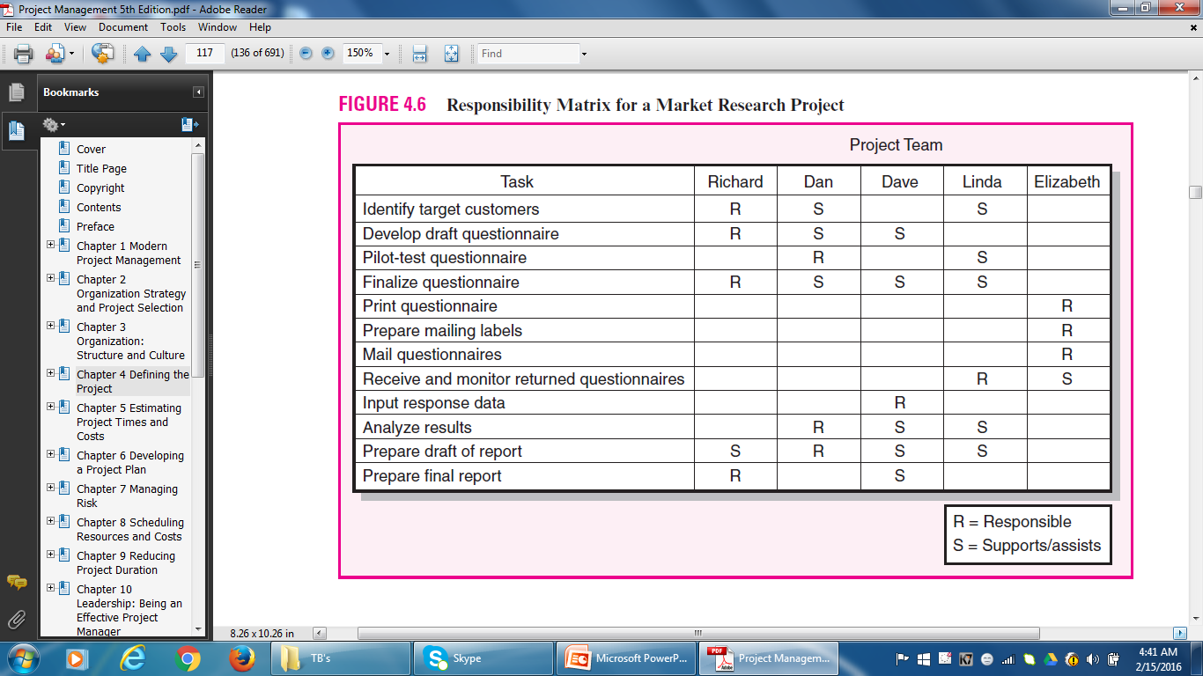
Responsibility Matrix

Slide 57
PROJECT COMMUNICATION PLAN
It is usually created by the PM and/or the Project Team in the early stage of Project Planning.
Communication is key to coordinating and tracking Project Schedules, Issues and Action Items.
It maps out the flow of information to different stakeholders and becomes an integral part of the overall project plan.
The purpose of a PCP is to express what, who, how and when information will be transmitted to project stakeholders so schedules, issues and action items can be tracked.

Slide 58
Project Communication Plan
PCPs address the following core questions:
What Information Needs to be Collected and When?
Who will Receive the Information?
What Methods will be used to Gather and Store Information?
What are the limits, if any, on who has access to certain kinds of information?
When will the information be communicated?
How will it be communicated?

Slide 59
STEPS
Developing a communication plan that answers these questions entails the following basic steps:
1. Stakeholder Analysis: Identify the target groups. Typical groups could be customer, sponsor, project team, project office.
2. Information Needs: Project Progress, Schedules, Task Lists, Specifications, Project Status Reports, Changes In Scope, Action Items, Deliverable Issues, Team Status Meetings, Accepted Request Changes, Milestone Reports.

Slide 60
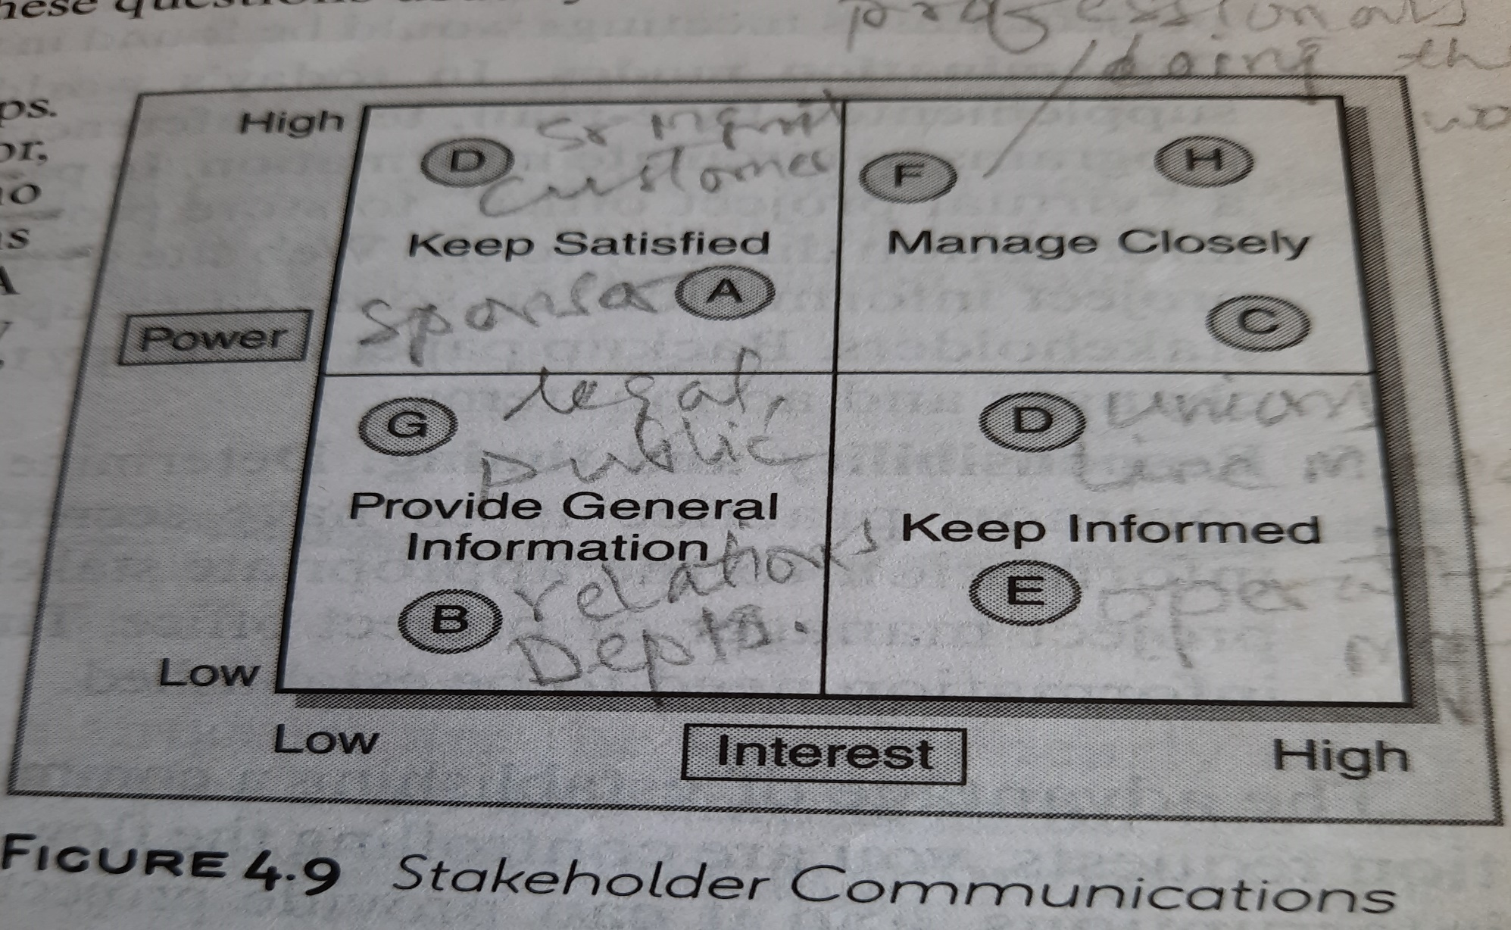
Stakeholder Analysis

Slide 61
Project Communication Plan
3. Sources Of Information: Where does the Information reside? How will it be collected?
4. Dissemination Modes: E-mail, Teleconferencing, etc. Create Virtual Project Office to store Project Information.
5. Responsibility and Timing: Determine who will send out the Information. Timing and frequency of distribution appropriate to the information need to be established.

Slide 62
Project Management
Thank You!

